Slide 1

CROWD STRIKE INDIA HACKATHON
ROUND 2 : Airline Scheduling
By : Team Valana
Aditi Joshi
Anaya Tulpule
Vallari Rajurkar

Slide 2
Contents
Technology/ Tool stack
The Scheduling problem : Approach
The Scheduling problem : Source code
The Optimal itinerary problem Approach
The Optimal itinerary problem Source code
The Demand dare problem : Approach
The Demand dare problem : Source code
Technical architecture / POC
Prototype demo (Video or screenshot)
Possible improvement
Challenges faced

Slide 3

Technology
Scheduling problem : Concepts of object oriented programming
Optimal itinerary : Graph theory (D. F. S.)
Demand dare problem : Machine learning concepts ( polynomial regression)

Slide 4
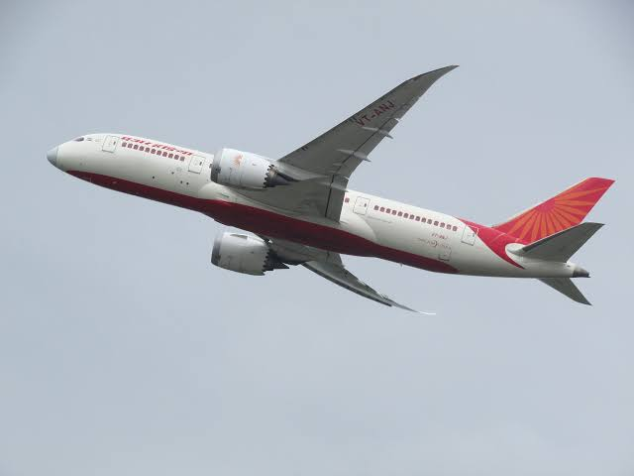
The scheduling problem : approach
The schedule is created by considering one airport at a time. These airports are prioritized on the basis of number of passengers to that city.
Then the various cities to which the flights depart from the airport are accepted.
Then the time slot in in our airport and the destination cities are reserved depending on the availability and duration of travel.
The next flight to the next city will be scheduled according to the free slots.

Slide 5

Video to explain scheduling approach: (Part 1)

Slide 6
Video to explain scheduling approach : (Part 2)

Slide 7
Video to explain scheduling approach : (Part 3)

Slide 8
The scheduling problem : source code
Please find the source code in the adjoining .java file saved as scheduling.java
Note: Scheduled according to IST

Slide 9
Optimal Itinerary :approach
For calculating the path with least number of
hops we use graph theory.
The algorithm used =Depth First Search (D.F.S.)
Explanation : In this algorithm we consider each city as a numerically assigned node and then we calculate all possible paths between the source and destination. After finding all the paths, we find the path with minimum hops.
If there are more than one paths with same number of hops, then compare the duration of travel and select the path with minimum travel time.

Slide 10
SAUDI ARABIA
UAE
INDIA
RIYADH
Abu-dhabi
DELHI
JEDDAH
DUBAI
MUMBAI
SHARJAH
DAMMAM
BANGLORE

Slide 11
Optimal Itinerary : source code
Please find the source code in the adjoining .java file saved as itinerary.java
We have considered the nodes or the cities as numbers .
The source is 0 and destination is 17 in our case.
The nodes in between are 1 to 16.

Slide 12
The demand dare problem: approach
For the demand dare problem , we use the concepts of machine learning .
A graph is plotted with the year on the X axis and the number of passengers on Y axis .
A non linear graph is obtained.
The demand can be found out using polynomial regression.
Polynomial regression fits a broad range of curvature.
It predicts the value of passengers at a particular time .
Then depending on that value the demand for any airline is obtained.

Slide 13
The demand dare problem: source code
Please find the source code in the adjoining ‘.py’ files.
There are 2 files: 2015 ,2016,2017 data for Air India .
We have assigned numbers to the months (eg: 1 for January,2 for February, and likewise for ease of plotting.)
We tested the data for 3rd , 4th and some higher order degree polynomials too .
Conclusion: 3rd degree polynomial regression was the best fit for the generated dataset.

Slide 14
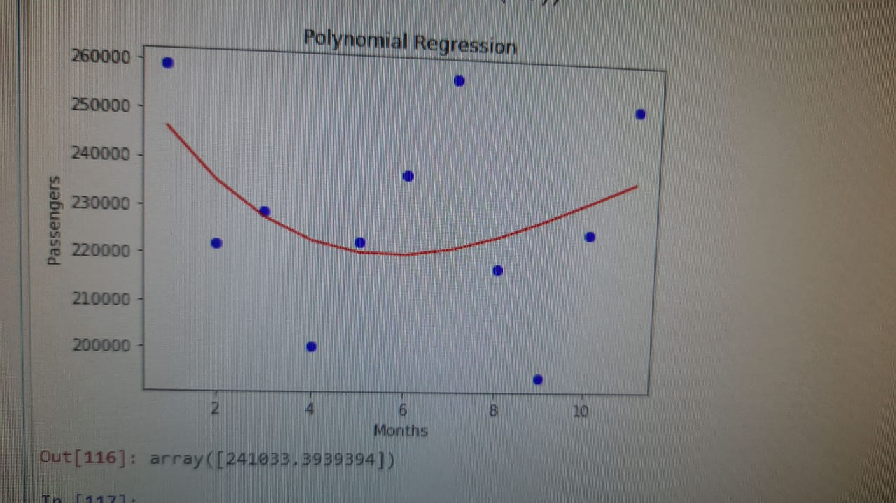
The demand dare problem:
Graph : Polynomial regression Air India
Predicted value =241033
Actual value = 286210

Slide 15

POC
We have focused on the logic involved for scheduling the flights over the data sets.
We tested various scheduling algorithms , and came to a solution which was totally formed by us.

Slide 16
Possible Improvement
We have excluded the delays caused due to the weather conditions and technical glitches. The schedule will be more accurate and realistic when these conditions are considered.
In the scheduling problem we have assumed that the time interval between every two flights is 1 hour. This time can be reduced to increase flight frequency.
We have done every solution using a small data. This is actually applicable for huge data too .Required changes can be made easily according to the dataset.

Slide 17

Challenges faced
Difficulty in obtaining the datasets for the travel time between cities.
Inadequate knowledge and available resources for understanding the current working system of flight scheduling.

Slide 18

Thank You !!

